Slide 1
Journey
Map
Deepthi Peter
Associate Data Engineer

Slide 2
Python (19/09/2023)
Key Learnings:
Functions in Python
Date and time formatting in Python
Recursive functions
Decorator functions

Slide 3
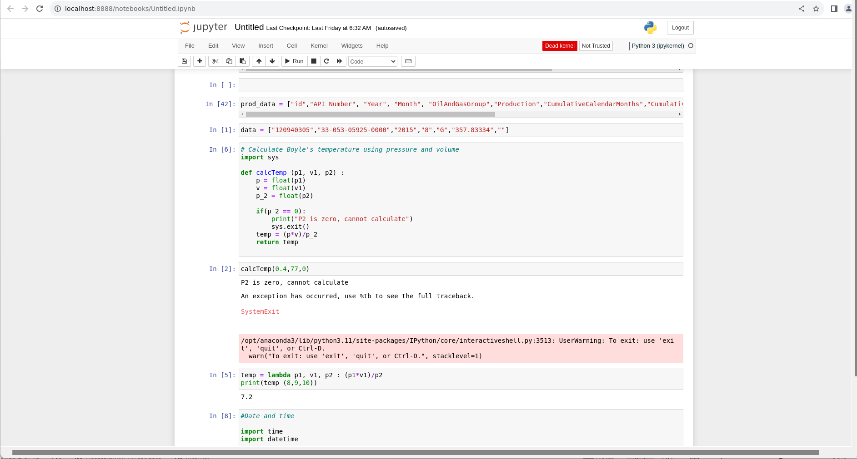

Slide 4
Python (20/09/2023)
Key Learnings:
Pandas
Pandas is an open-source library in Python that is made mainly for working with relational or labeled data both easily and intuitively
Data produced by Pandas are often used as input for plotting functions of Matplotlib, statistical analysis in SciPy, and machine learning algorithms in Scikit-learn
Plots using Matplotlib

Slide 5
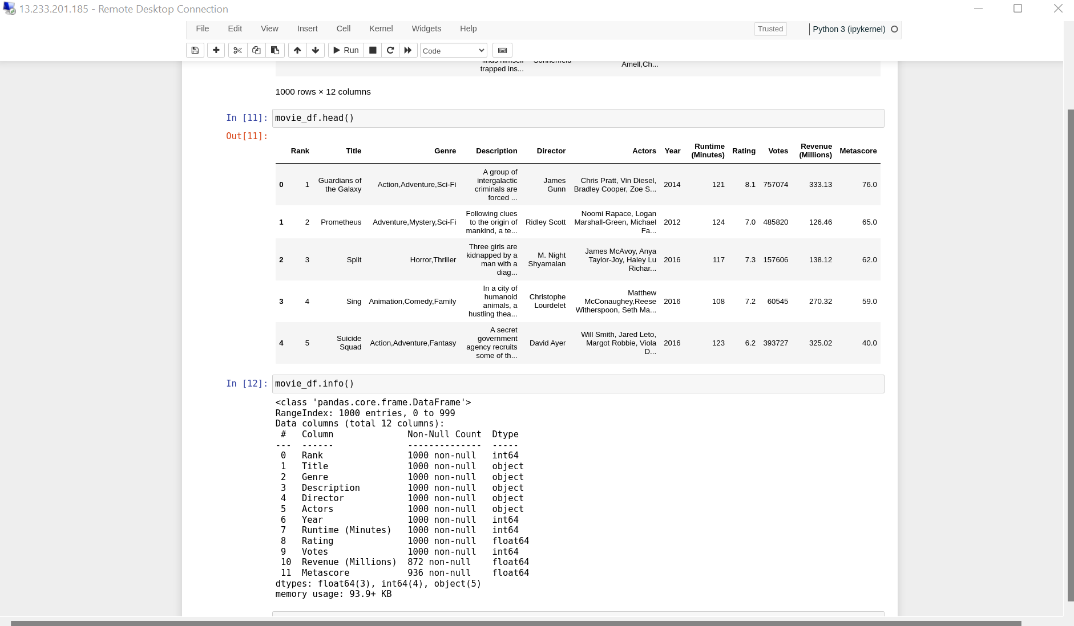
Pandas Dataframes

Slide 6
PySpark (21/09/2023)
Key Learnings:
PySpark is a Python API for Spark.
PySpark helps interface with Resilient Distributed Datasets (RDDs) in Apache Spark and Python
PySpark supports all of Spark’s features such as Spark SQL, DataFrames, Structured Streaming, Machine Learning (MLlib) and Spark Core.
PySpark includes features such as disk and memory caching to help improve the performance of data processing tasks

Slide 7
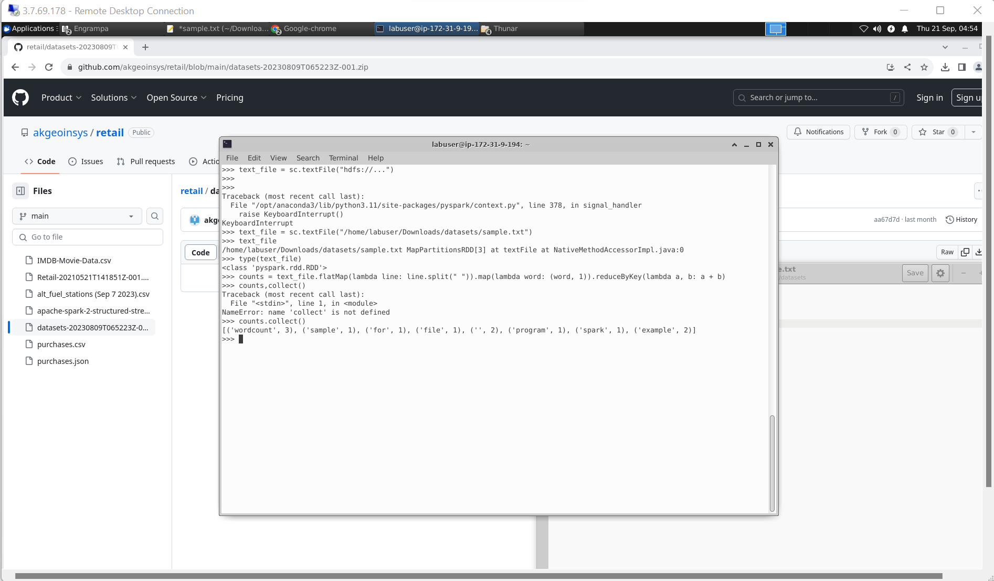
Wordcount program using PySpark

Slide 8
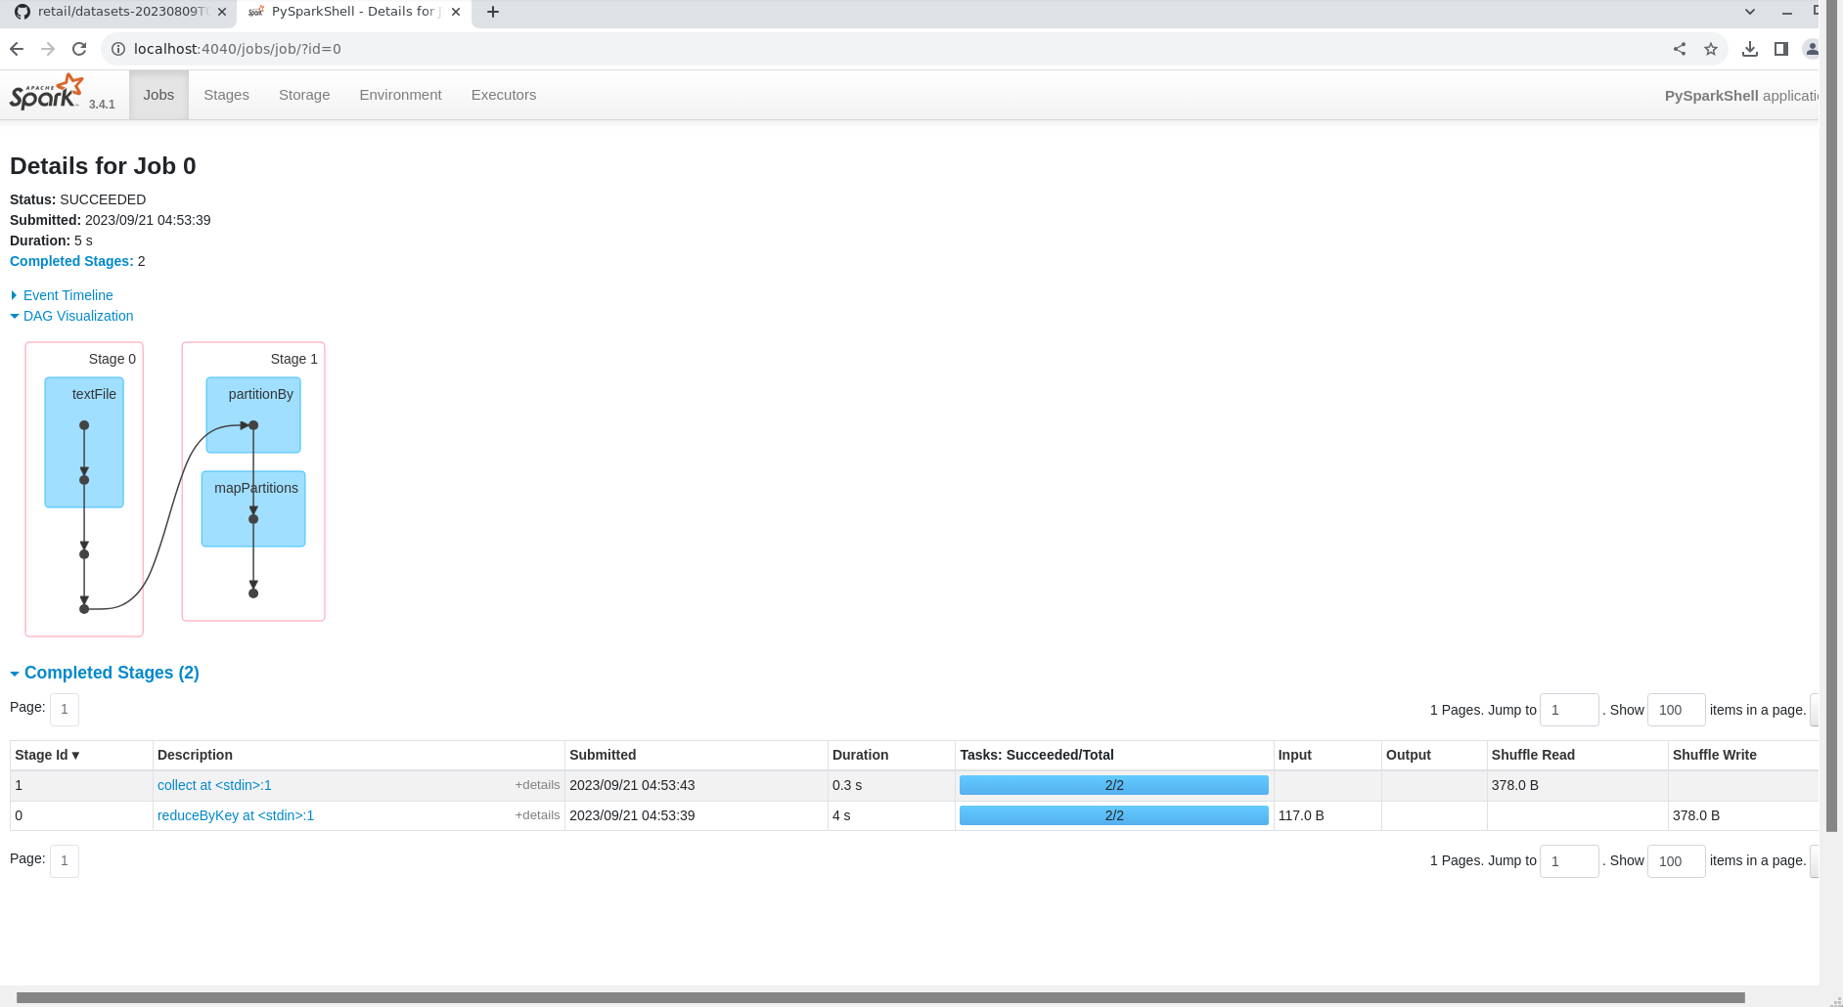
Spark Jobs

Slide 9
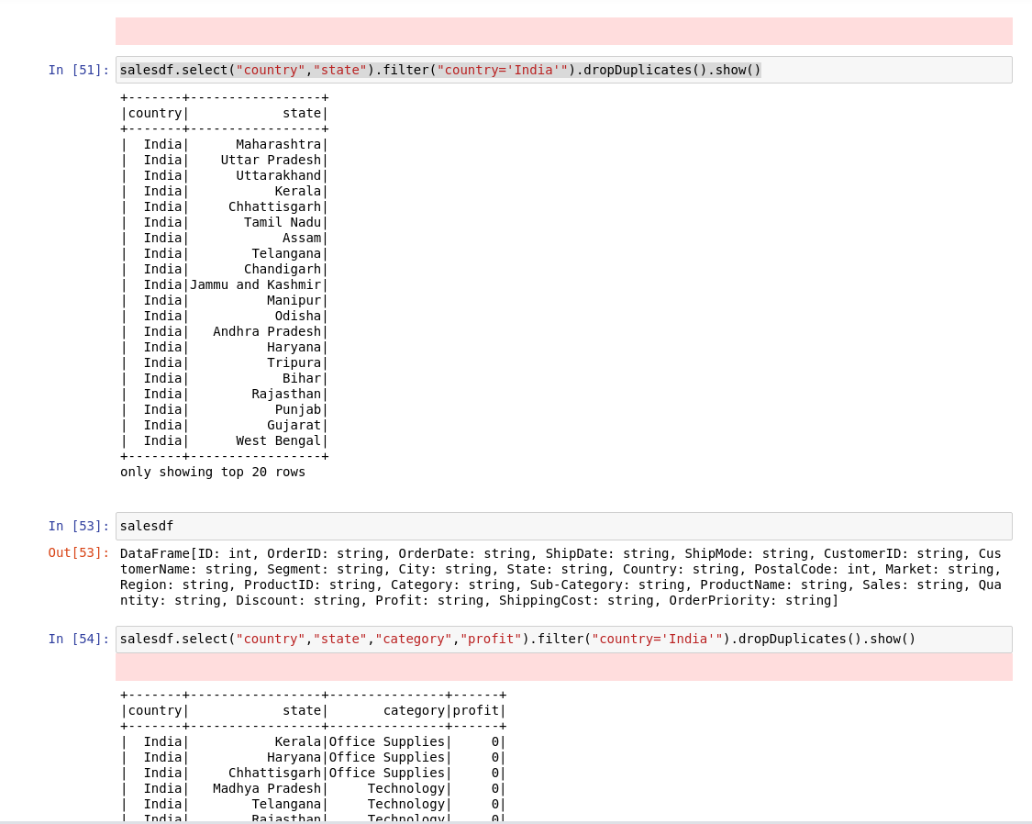
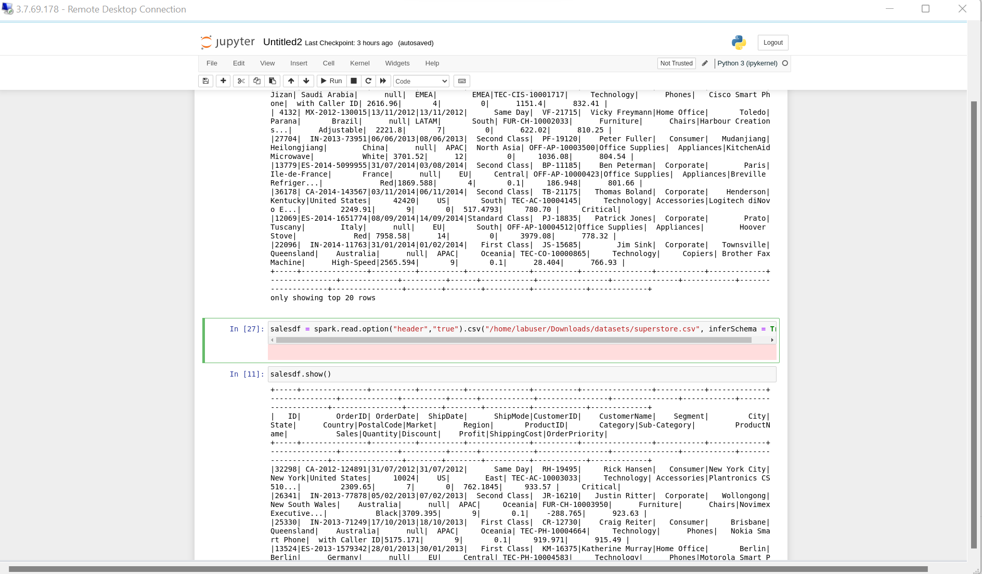
Operations on data

Slide 10
PySpark (22/09/2023)
Key Learnings:
Spark-submit - used to launch applications on a cluster
Wordcount program using python
Parquet and Orc files
Run SQL queries through Spark
Caching in Spark

Slide 11
Run SQL queries using PySpark

Slide 12
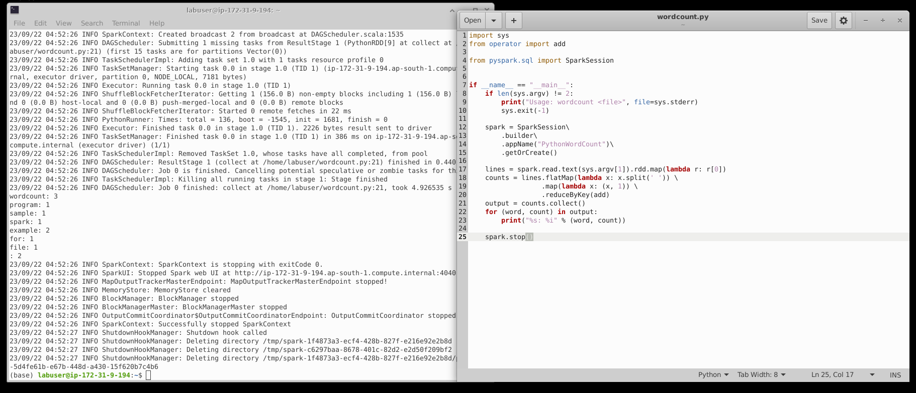
wordcount.py

Slide 13
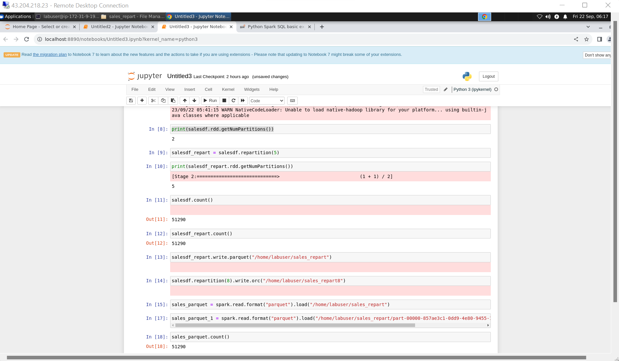
Parquet file format

Slide 14
Thank You

